Slide 1
All About Leasing and Rents

Slide 2

Agenda
OneSite
Self-Start Conversion
RO Assisted Conversion
Conversion Scheduling Weeks
Different Conversion Types
Conversion Timelines
Notes:
High-level; no more than 30 seconds!

Slide 3
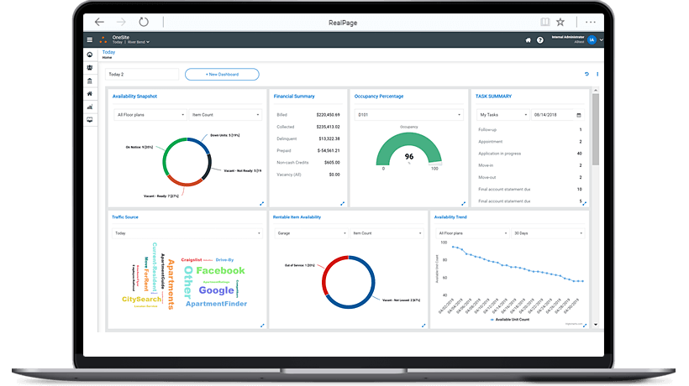
PROPERTY MANAGEMENT SOFTWARE
®
ONESITE
This software simplifies the entire management process, giving clients the confidence on their business policies being integrated into daily workflows across their properties.
    OneSite Leasing and Rents
    Rent Stabilization
manages the entire renter lifecycle, simply and seamlessly, from the moment they enter the system as prospects until the day they move out.
Manage and automate the renter lifecycle for properties under Rent regulation laws (New York)
    Senior Living
integrates and automates every functionality to make the most of clients’ senior living property assets
    OneSite Affordable
Seamlessly stay in compliance with HUD, Tax Credits, Rural Housing regulations and the 50058 Public Housing program.
    Student Living
Simplifying renter services for students with the ability to manage their living experience 24-hours a day on this platform

Slide 4
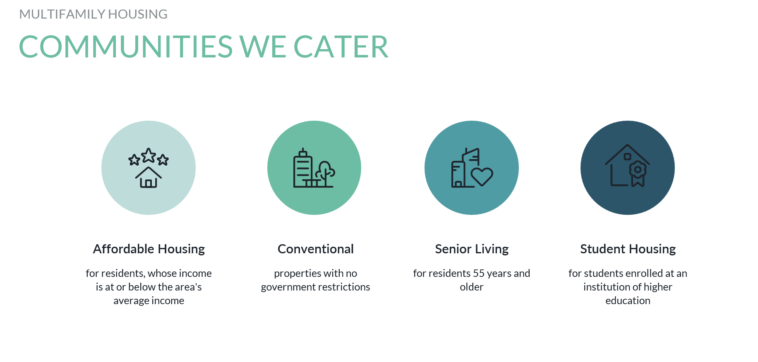

Slide 5
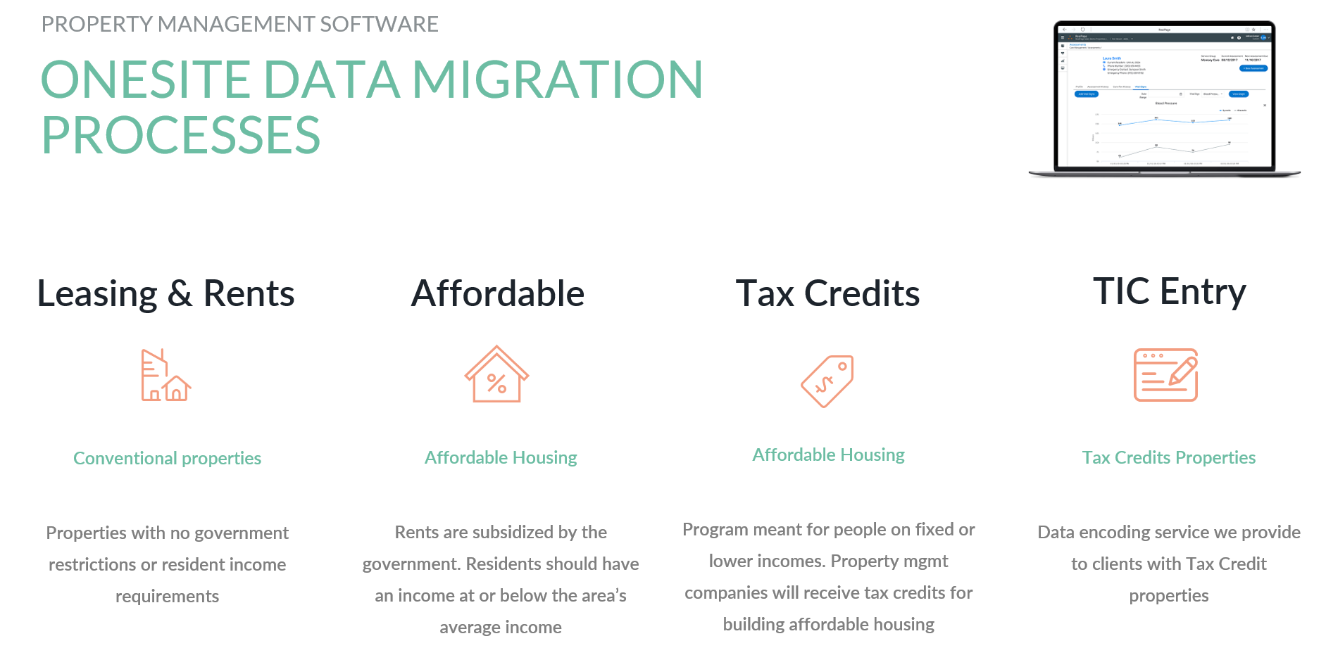

Slide 6
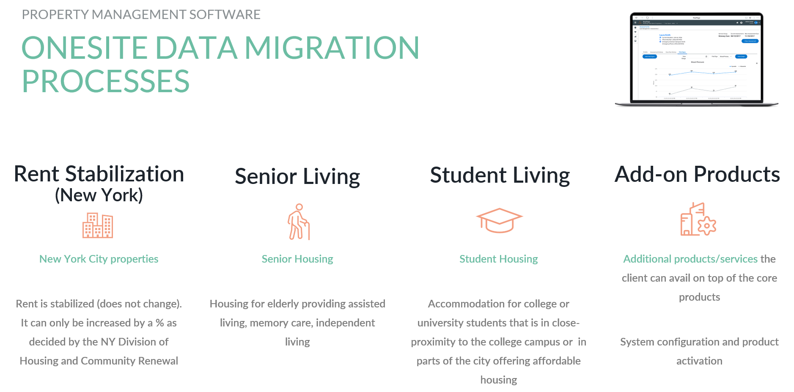

Slide 7
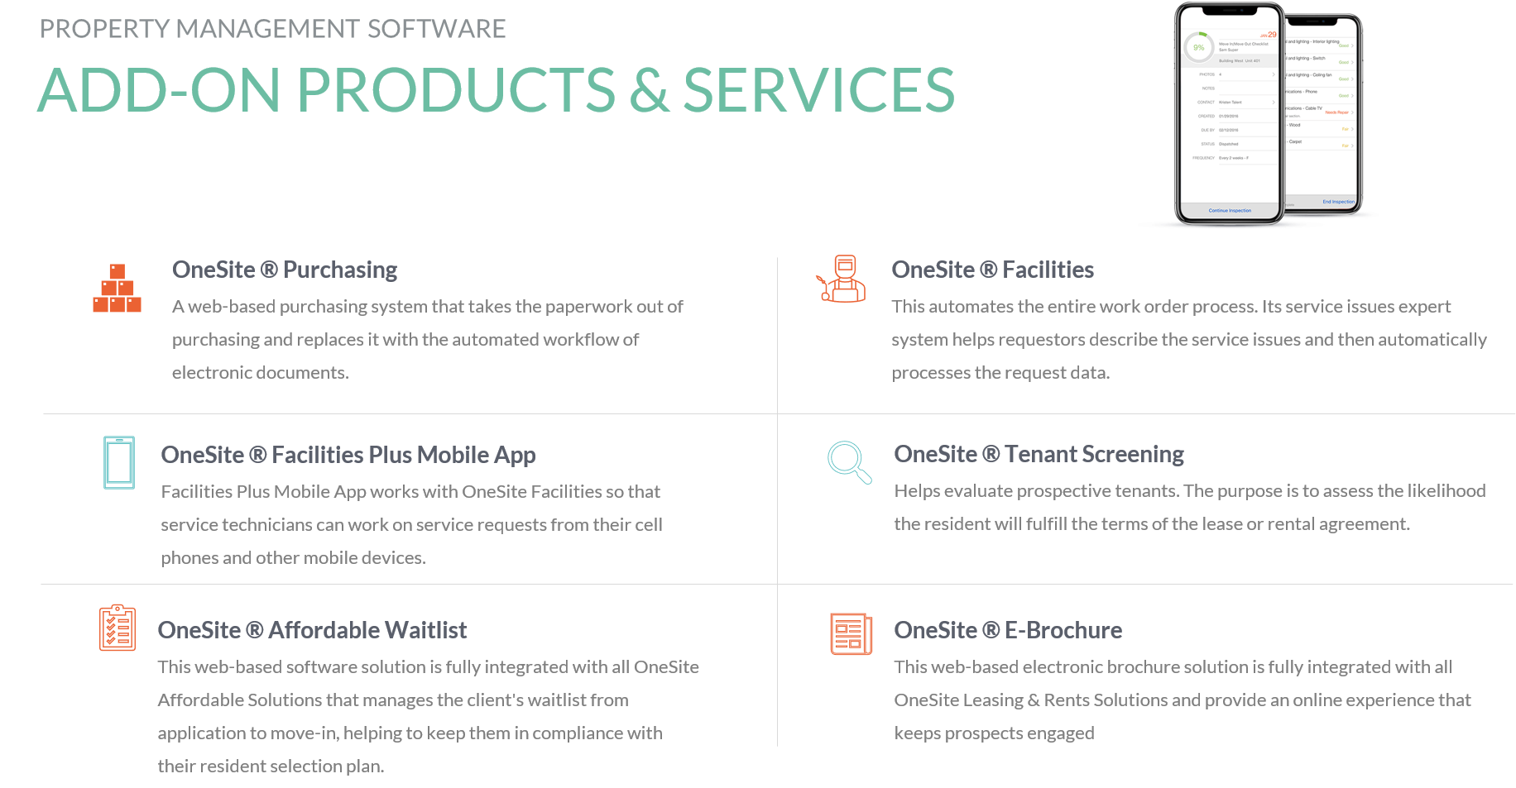

Slide 8
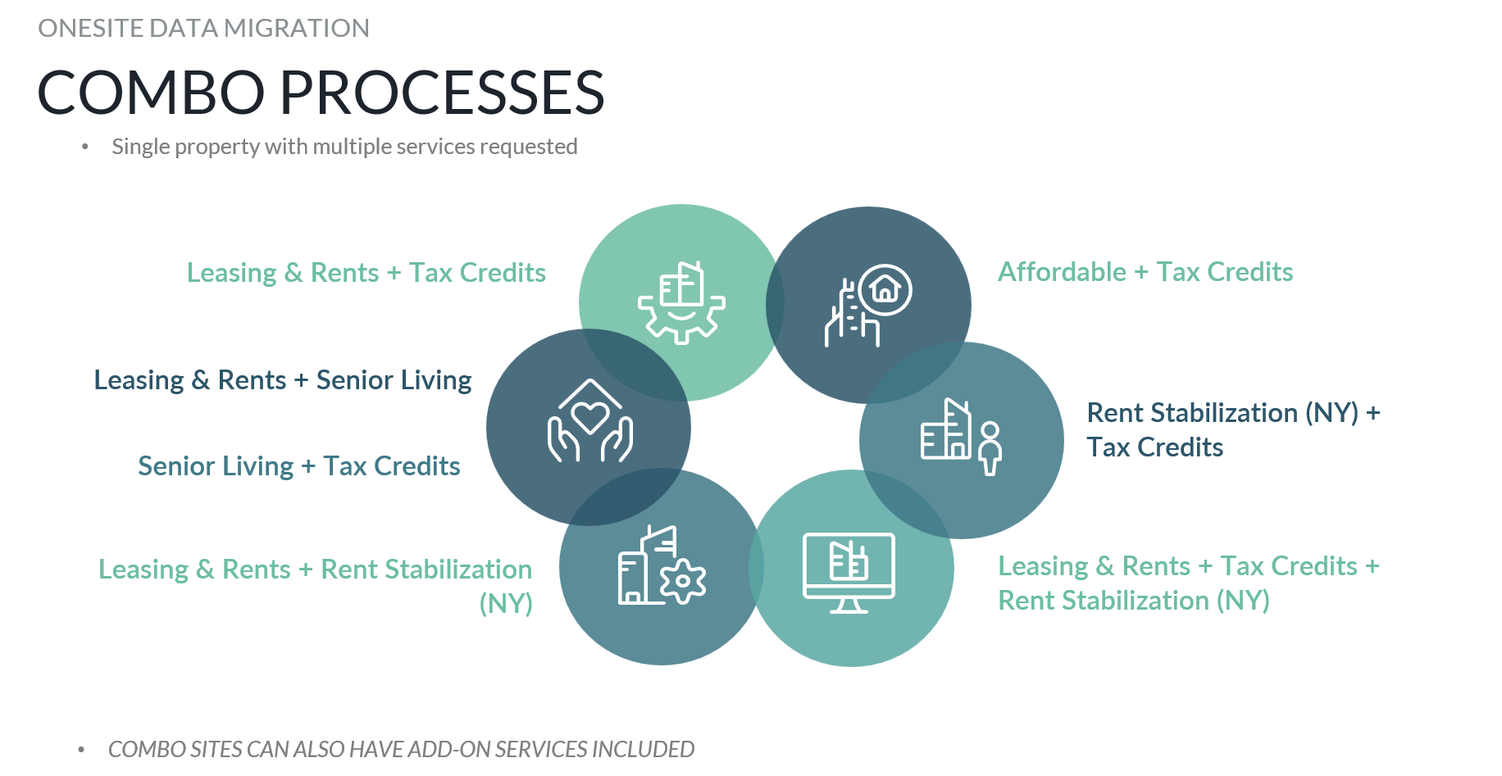

Slide 9

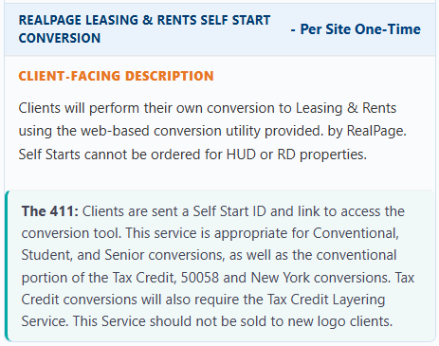
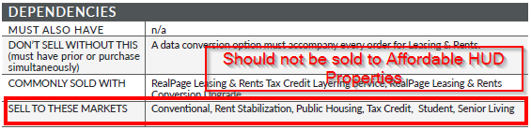
Self-Start Conversion

Slide 10
Self-Start Conversion
Clients will do the conversion themselves
EC to ask clients when they would like to receive the self-start email
  EC to reach out to Scheduling team to schedule self-start
    If applicable provide property to mirror – for screening orders
Conversion Support conversions@realpage.com
Client dependent Timelines
  EC to ask for client’s target go live
ICD date in Salesforce is based on when the self-start email was sent
  REMINDER: DO NOT use the ICD date as your OneSite go live date
  Where to check OneSite go live:
    Engagement Management Self Starts
    Digital Dashboard
    OneSite go live date on any SF Order (Order details)

Slide 11

Standard Data/+Upgraded Conversion
RP will do the conversion
Reach out to scheduling for available conversion schedules
  Conversion Scheduling Weeks in Salesforce
    Limited slots per schedule
    Special reminders on some schedules
Realpage.Migrations RealpageMigrations2@RealPage.com
  Determine assigned Implementation Analyst
Deliverables in DataHub
Close coordination is crucial as delays in submitting and validating deliverables may result to upto 2 weeks delay in completion
  Remind clients that they should be available to respond to inquiries from the Migrations team
Starts on a Monday and usually takes 8 business days to complete
  Day 1-3 Data Validation
  Day 4-8 Conversion

Slide 12
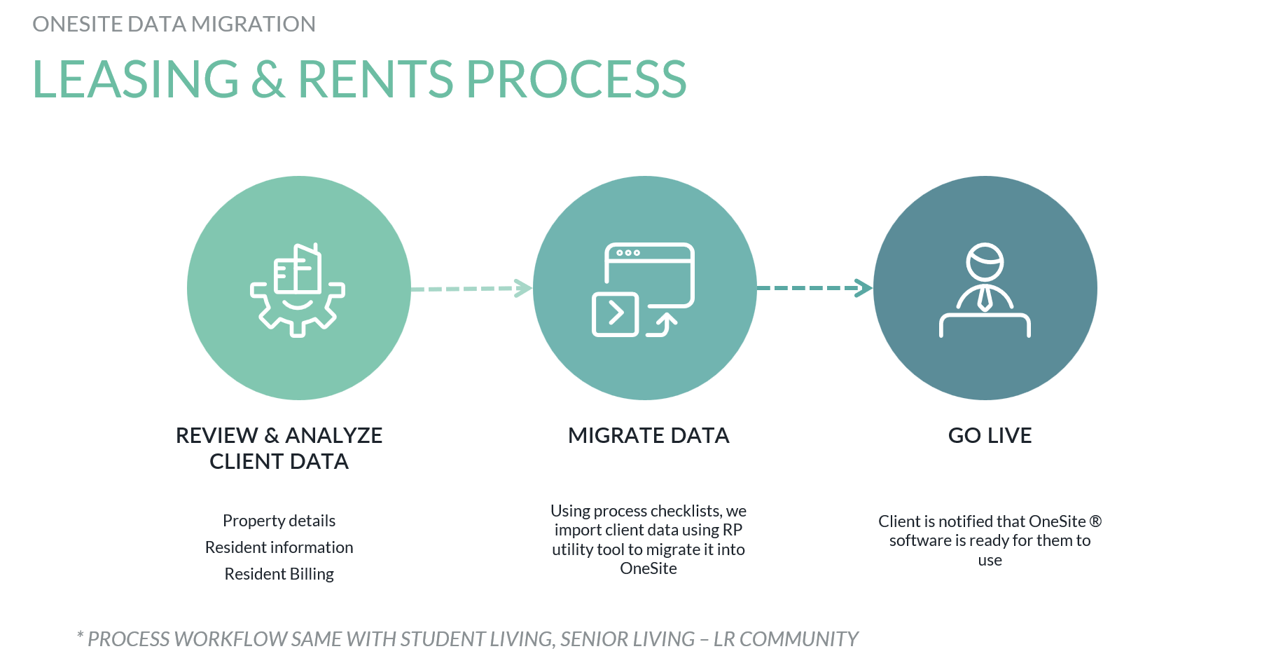

Slide 13


Slide 14
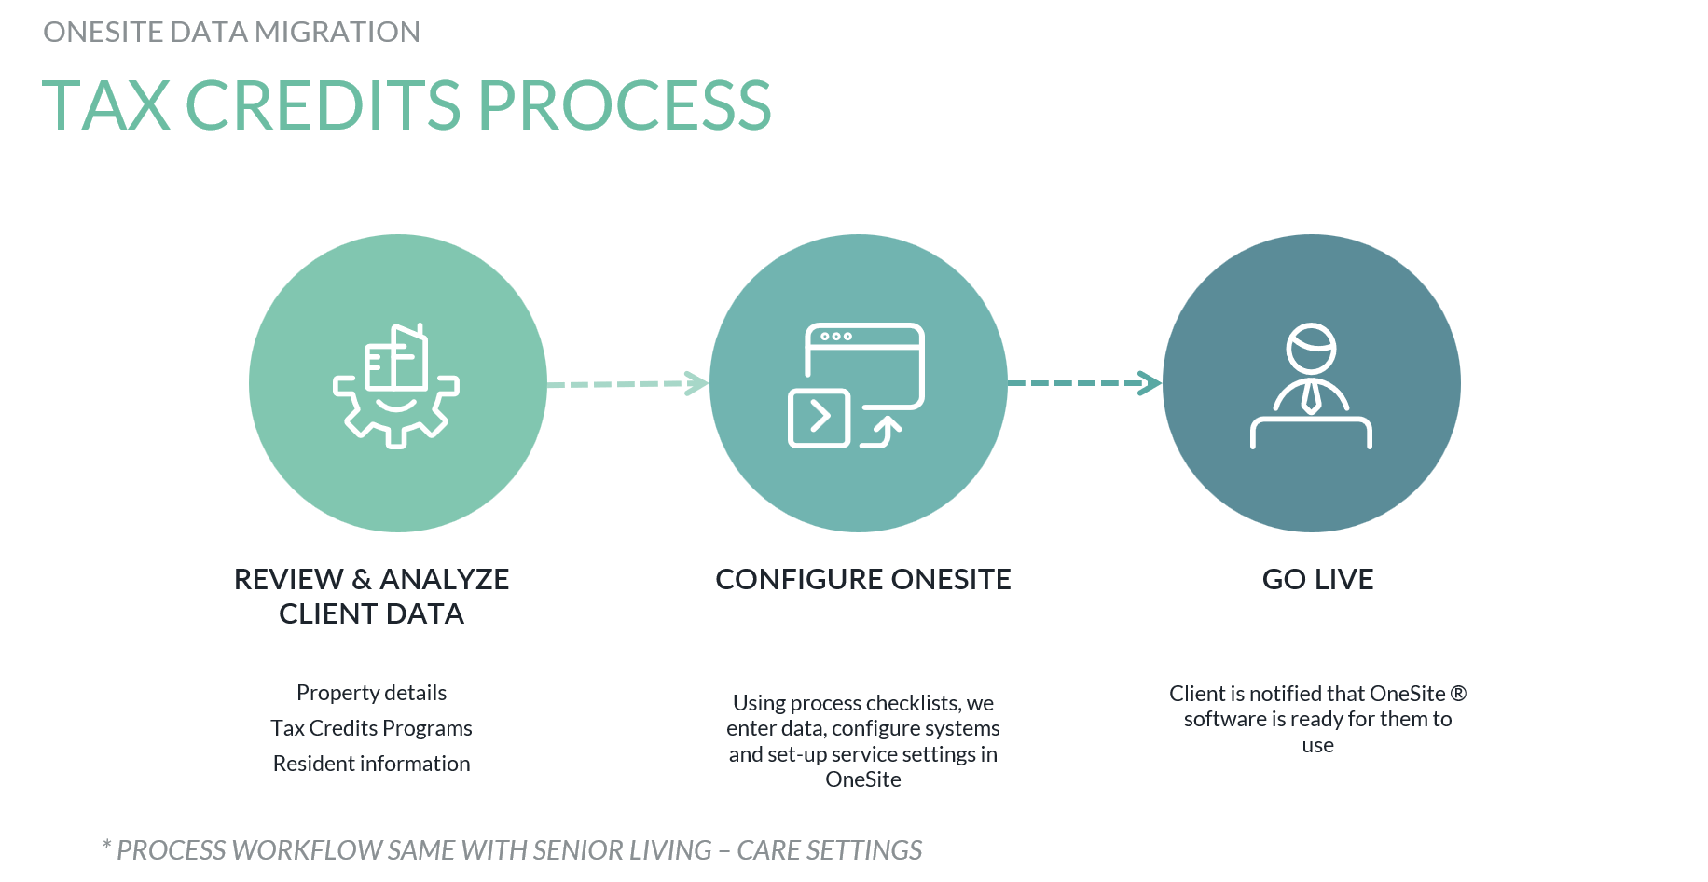

Slide 15
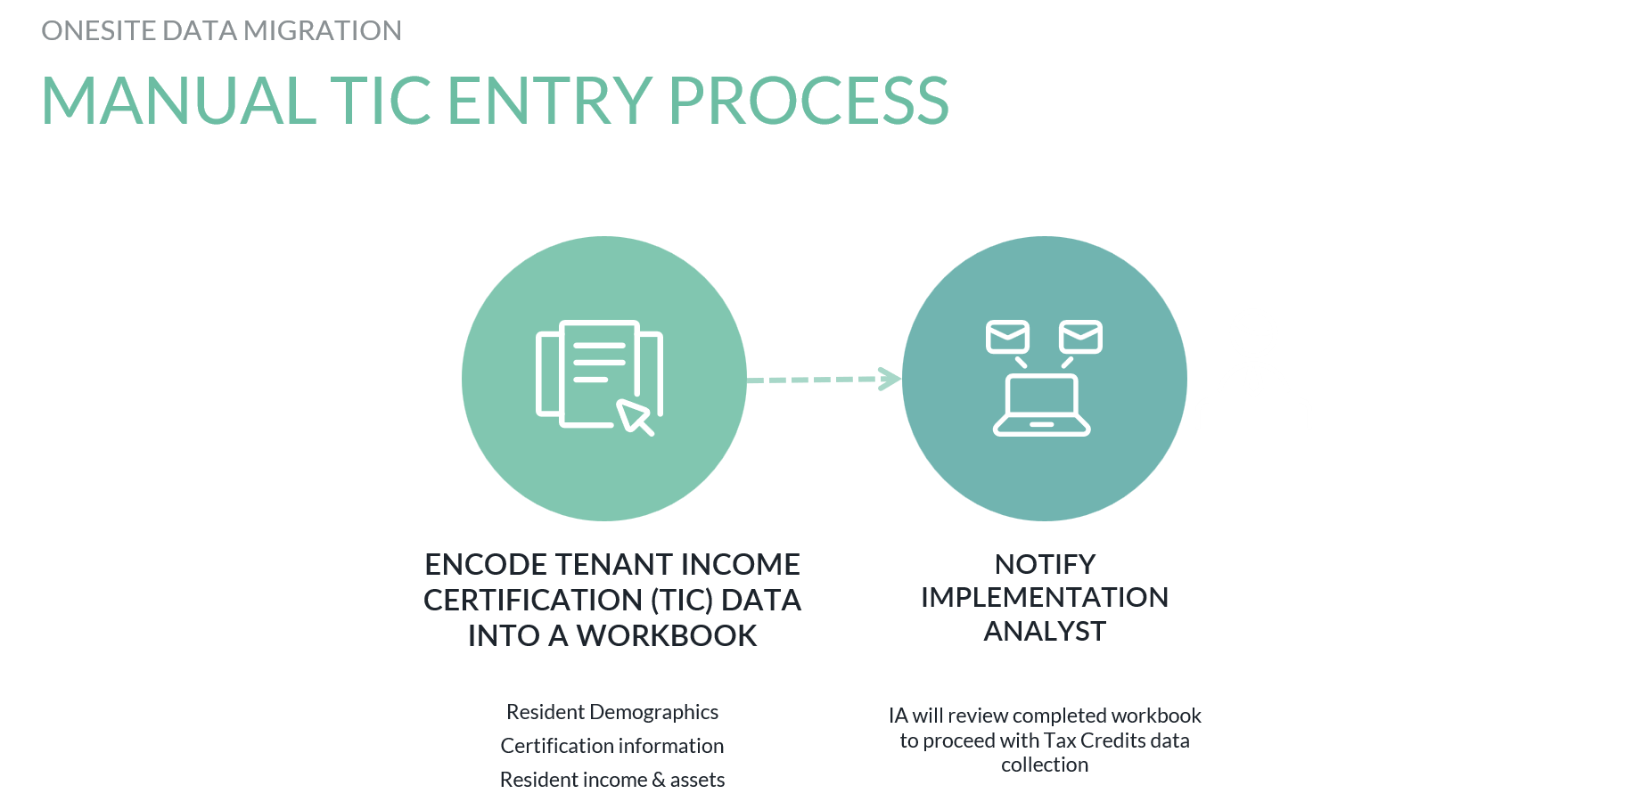

Slide 16
Conversion Types
Conventional | Affordable | Tax Credit | Combo (Aff + TC)
Self-Start Standard Data Conversion Conversion Upgrade OneSite Transfer OneSite Transfer with Retrofit OneSite Conversion | Standard Data Conversion OneSite Transfer OneSite Transfer with Retrofit OneSite Conversion | Self-Start (Conv) + TC Layering Standard Data Conversion + TC Layering Standard + Upgrade + TC Layering TIC Entry Services* | Standard Data Conversion + TC Layering OS Transfer OS Transfer with Retrofit OneSite Conversion
** New Business Model will require consulting orders **

Slide 17
Conversion/Transfer
Self-Start | Standard Data Conversion | Conversion Upgrade | OneSite Transfer
Client RP Utility Tool Conversion Support Screening Scoring Model Go live depends on client SF ICD is the date we sent the self-start email | RealPage Migrations DataHub + Data Source File Scheduled Typically 8 business days but depends on deliverables submission | RealPage Migrations Should always be sold with Standard Data Conversion Scheduled**** Cannot be used for HUD DSF not needed DataHub + Reports | Copy and Paste from exiting PMC Debbie Estes or Staci Yancy Done in a day Needs Cancellation Effective Date

Slide 18
Conversion/Transfer
OneSite Transfer with Retrofit or Full Retrofit | OneSite Conversion | Tax Credit Layering | TIC Entry
Copy and Paste + map to Business Model Debbie Estes or Staci Yancy 1 day transfer + 5 business days Retrofit Needs Cancellation Effective Date Hands off until retrofit is completed | Beginning Balances, Demographics, Unit setup and floorplan info RealPage Migrations Debbie and Staci Data Source File*** Typically 8 business days but can be shorter Needs cancellation eff date | RealPage Migrations Self-start/RP Assisted Scheduled DataHub + TC Workbook If Self-start –SS must be completed before TC Schedule If RP Assisted – can be scheduled at the same time or separately Separate – recommend to be done mid-month (dark period) | Should be scheduled 2 weeks before TC Layering Most recent certification for all occupied/qualified units. TC Workbook completed (General - Unit List tabs). Any Demographic reports/documents for the property (if not in TIC).

Slide 19
GO-LIVE PLANNING
SUNDAY
MONDAY
TUESDAY
WEDNESDAY
THURSDAY
FRIDAY
SATURDAY
28
29
30
1
2
3
4
5
6
7
8
9
10
11
Property Management Conversion Period
12
13
14
15
16
17
18
Property Management Conversion Period
Go Live with Phase 1 Products
Start Catch-up Work
19
20
21
22
23
24
25
26
27
28
29
30
31
1
Notes:
This is an example of the conversion and go live timeline. The prior slide was intended to give a macro view on how all products are onboarding. This slide is a zoomed in view on the actual go live month. The site(s) will go into conversion on a Monday and they will be delivered back to you the following Wednesday. During the conversion period, the site staff will need to track activity manually. They will not have access to a property management system or any other functions that previously lived within your prop mgmt system, such as Screening. No data such as payments, move-ins/outs, or background checks should be done in your old system during the dark period. . Your site staff will begin catch up work once the conversion is complete and the site is delivered back you. And we will "go live" will all products in Phase 1 from prior slide, the following day.
**If the property is a COMBO property (ex. HUD/Tax combo), they will have an extra week of conversions, so that property wouldn't come out of conversion until the following Wednesday (22nd in the example above)
*If we happen to know the true conversion dates, update the calendar to reflect those specific dates.*

Slide 20


Thank You

